Slide 1
Mediation analysis in the AFT framework
A mediator (M) is a factor that lies and mediate the relation between an exposure (X) and on outcome (Y)
c
X
Y
c ← Direct effect
a*b ← Indirect effect
c + a*b ← Total effect
Let’s imagine the relation between hypertension (HYP) and cardiovascular disease risk (CVD) with endothelial dysfunction acting as mediator
a
b
M

Slide 2
Mediation analysis in the AFT framework
A mediator (M) is a factor that lies and mediate the relation between an exposure (X) and on outcome (Y)
c
HYP
CVD
c ← Direct effect
a*b ← Indirect effect
c + a*b ← Total effect
a
b
ED

Slide 3
Mediation analysis in the AFT framework
A mediator (M) is a factor that lies and mediate the relation between an exposure (X) and on outcome (Y)
c
HYP
CVD
c ← Direct effect
a*b ← Indirect effect
c + a*b ← Total effect
a
b
ED

Slide 4
Mediation analysis in the AFT framework
A mediator (M) is a factor that lies and mediate the relation between an exposure (X) and on outcome (Y)
c
HYP
CVD
c ← Direct effect
a*b ← Indirect effect
c + a*b ← Total effect
a
b
ED

Slide 5
Mediation analysis in the AFT framework
A mediator (M) is a factor that lies and mediate the relation between an exposure (X) and on outcome (Y)
c
HYP
CVD
c ← Direct effect
a*b ← Indirect effect
c + a*b ← Total effect
a
b
ED
This approach answers questions like: “How much of the effect of hypertension on cardiovascular disease is mediated through endothelial dysfunction?”
In the AFT framework the question is: “How much does hypertension accelerate the occurrence of cardiovascular disease, and to what extent is that acceleration explained by its effect on endothelial dysfunction?”
In the counterfactual causation approach (Van der Weele)
NDE: The Natural Direct Effect is the effect of hypertension on the time to CVD, holding endothelial dysfunction constant at the level it would take if the person were not hypertensive
…If we could somehow prevent hypertension from damaging endothelial function, but a person still had hypertension, how much would hypertension on its own (through other mechanisms) speed up the onset of cardiovascular disease?

Slide 6
Mediation analysis in the AFT framework
A mediator (M) is a factor that lies and mediate the relation between an exposure (X) and on outcome (Y)
c
HYP
CVD
c ← Direct effect
a*b ← Indirect effect
c + a*b ← Total effect
a
b
ED
This approach answers questions like: “How much of the effect of hypertension on cardiovascular disease is mediated through endothelial dysfunction?”
In the AFT framework the question is: “How much does hypertension accelerate the occurrence of cardiovascular disease, and to what extent is that acceleration explained by its effect on endothelial dysfunction?”
In the counterfactual causation approach (Van der Weele)
NIE: The Natural Indirect Effect is the portion of hypertension’s effect on time to CVD that is due to its effect on endothelial dysfunction, which then influences CVD timing
…the NIE tells us how much earlier CVD occurs due to endothelial dysfunction caused by hypertension (assuming the person’s hypertension status stays the same)

Slide 7
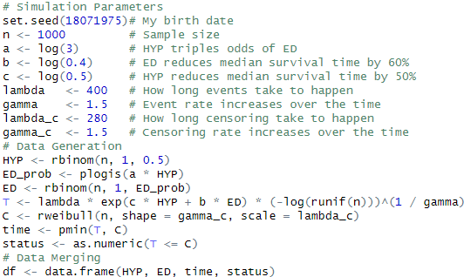
Mediation analysis in the AFT framework -Data simulation-
Simulation parameters

Slide 8

Mediation analysis in the AFT framework -Data simulation-

Slide 9
Mediation analysis in the AFT framework -Data simulation-
T ~ W(γ, λ)

Slide 10
Mediation analysis in the AFT framework -Data simulation-
Data Generation

Slide 11
Mediation analysis in the AFT framework -Data simulation-
Hypertension: Random 50% of participants has hypertension

Slide 12
Mediation analysis in the AFT framework -Data simulation-
The hypertension increases the risk of endothelial dysfunction by a factor of 3

Slide 13
Mediation analysis in the AFT framework -Data simulation-
The time to event is simulated using a Weibull distribution considering the above simulation settings

Slide 14
Mediation analysis in the AFT framework -Data simulation-
Censoring time (drop out of subjects/exit) is also simulated T ~ W(γ_{c}, λ_{c})

Slide 15
Mediation analysis in the AFT framework -Data simulation-
The observed time (for event or censored) is the minimum between T and C

Slide 16
Mediation analysis in the AFT framework -Data simulation-
We observe an event if T ≤ C

Slide 17
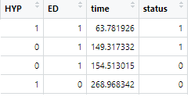
Mediation analysis in the AFT framework -Data simulation-
Data are merged into a data frame

Slide 18
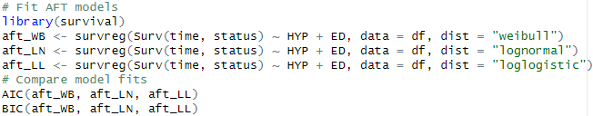
Mediation analysis in the AFT framework -Data simulation-
Check for Weibull fitting

Slide 19

Mediation analysis in the AFT framework -Data simulation-
The lower the better

Slide 20

Mediation analysis in the AFT framework -Data simulation-
The lower the better

Slide 21
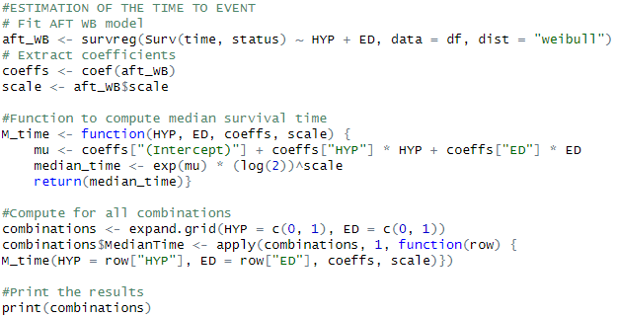
Mediation analysis in the AFT framework -Data analysis: Estimation of time to event due to HYP and ED-
Fitting of the AFT model and output the coefficient and the scale parameter

Slide 22

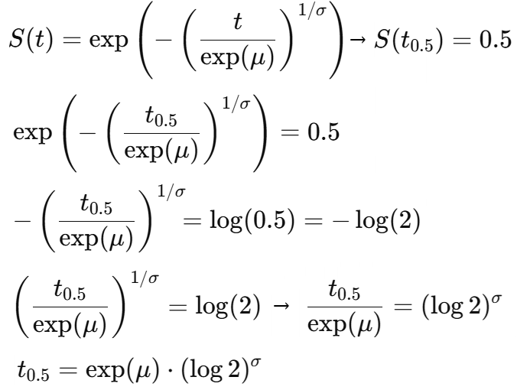
Mediation analysis in the AFT framework -Data analysis: Estimation of time to event due to HYP and ED-
The median time is defined for a general Weibull distribution
Little of algebra…

Slide 23
Mediation analysis in the AFT framework -Data analysis: Estimation of time to event due to HYP and ED-
The median time is performed for all HYP and ED combinations

Slide 24

Mediation analysis in the AFT framework -Data analysis: Estimation of time to event due to HYP and ED-
HYP and ED reduces the “survivorship” or accelerate the outcome and so the time to event

Slide 25
Mediation analysis in the AFT framework -Data analysis: Counterfactual mediation analysis-
Custom program for mediation analysis in the AFT models; it’s a simple idea...
https://github.com/cristianricciwork-commits/aft-mediation./blob/main/Mediation%20analysis.R
We need to estimate median survival times under the counterfactual scenarios; the counterfactual effects will be given by survival time differences between certain categories (We already estimated median survival times)
The NDE is the effect of hypertension on the time to CVD, holding endothelial dysfunction constant at the level it would take if the person were not hypertensive
NDE = T*₁ – T₀
Counterfactual survival time:
What is the median survival if HYP = 1, but the distribution of ED is still as if HYP = 0?
(1-P(ED = 1|HYP = 0))*T(ED = 0 & HYP =1) + P(ED = 1|HYP = 1)*T(ED = 1 & HYP =1)
Probability of no endothelial dysfunction when there is no hypertension

Slide 26
Mediation analysis in the AFT framework -Data analysis: Counterfactual mediation analysis-
Custom program for mediation analysis in the AFT models; it’s a simple idea...
https://github.com/cristianricciwork-commits/aft-mediation./blob/main/Mediation%20analysis.R
We need to estimate median survival times under the counterfactual scenarios; the counterfactual effects will be given by survival time differences between certain categories (We already estimated median survival times)
The NDE is the effect of hypertension on the time to CVD, holding endothelial dysfunction constant at the level it would take if the person were not hypertensive
NDE = T*₁ – T₀
Counterfactual survival time:
What is the median survival if HYP = 1, but the distribution of ED is still as if HYP = 0?
(1-P(ED = 1|HYP = 0))*T(ED = 0 & HYP =1) + P(ED = 1|HYP = 1)*T(ED = 1 & HYP =1)
Median survival time for hypertensive subjects without ED

Slide 27
Mediation analysis in the AFT framework -Data analysis: Counterfactual mediation analysis-
Custom program for mediation analysis in the AFT models; it’s a simple idea...
https://github.com/cristianricciwork-commits/aft-mediation./blob/main/Mediation%20analysis.R
We need to estimate median survival times under the counterfactual scenarios; the counterfactual effects will be given by survival time differences between certain categories (We already estimated median survival times)
The NDE is the effect of hypertension on the time to CVD, holding endothelial dysfunction constant at the level it would take if the person were not hypertensive
NDE = T*₁ – T₀
Counterfactual survival time:
What is the median survival if HYP = 1, but the distribution of ED is still as if HYP = 0?
(1-P(ED = 1|HYP = 0))*T(ED = 0 & HYP =1) + P(ED = 1|HYP = 1)*T(ED = 1 & HYP =1)
Median survival time for hypertensive subjects without ED weighted by the probability of no ED when there is no HYP

Slide 28
Mediation analysis in the AFT framework -Data analysis: Counterfactual mediation analysis-
Custom program for mediation analysis in the AFT models; it’s a simple idea...
https://github.com/cristianricciwork-commits/aft-mediation./blob/main/Mediation%20analysis.R
We need to estimate median survival times under the counterfactual scenarios; the counterfactual effects will be given by survival time differences between certain categories (We already estimated median survival times)
The NDE is the effect of hypertension on the time to CVD, holding endothelial dysfunction constant at the level it would take if the person were not hypertensive
NDE = T*₁ – T₀
Counterfactual survival time:
What is the median survival if HYP = 1, but the distribution of ED is still as if HYP = 0?
(1-P(ED = 1|HYP = 0))*T(ED = 0 & HYP =1) + P(ED = 1|HYP = 0)*T(ED = 1 & HYP =1)
Probability of endothelial dysfunction in non hypertensive subjects

Slide 29
Mediation analysis in the AFT framework -Data analysis: Counterfactual mediation analysis-
Custom program for mediation analysis in the AFT models; it’s a simple idea...
https://github.com/cristianricciwork-commits/aft-mediation./blob/main/Mediation%20analysis.R
We need to estimate median survival times under the counterfactual scenarios; the counterfactual effects will be given by survival time differences between certain categories (We already estimated median survival times)
The NDE is the effect of hypertension on the time to CVD, holding endothelial dysfunction constant at the level it would take if the person were not hypertensive
NDE = T*₁ – T₀
Counterfactual survival time:
What is the median survival if HYP = 1, but the distribution of ED is still as if HYP = 0?
(1-P(ED = 1|HYP = 0))*T(ED = 0 & HYP =1) + P(ED = 1|HYP = 0)*T(ED = 1 & HYP =1)
Median survival time for hypertensive subjects with ED

Slide 30
Mediation analysis in the AFT framework -Data analysis: Counterfactual mediation analysis-
Custom program for mediation analysis in the AFT models; it’s a simple idea...
https://github.com/cristianricciwork-commits/aft-mediation./blob/main/Mediation%20analysis.R
We need to estimate median survival times under the counterfactual scenarios; the counterfactual effects will be given by survival time differences between certain categories (We already estimated median survival times)
The NDE is the effect of hypertension on the time to CVD, holding endothelial dysfunction constant at the level it would take if the person were not hypertensive
NDE = T*₁ – T₀
Counterfactual survival time:
What is the median survival if HYP = 1, but the distribution of ED is still as if HYP = 0?
(1-P(ED = 1|HYP = 0))*T(ED = 0 & HYP =1) + P(ED = 1|HYP = 0)*T(ED = 1 & HYP =1)
Median survival time for hypertensive subjects with ED weighted by the Probability of endothelial dysfunction in non hypertensive subjects

Slide 31
Mediation analysis in the AFT framework -Data analysis: Counterfactual mediation analysis-
Custom program for mediation analysis in the AFT models; it’s a simple idea...
https://github.com/cristianricciwork-commits/aft-mediation./blob/main/Mediation%20analysis.R
We need to estimate median survival times under the counterfactual scenarios; the counterfactual effects will be given by survival time differences between certain categories (We already estimated median survival times)
The NDE is the effect of hypertension on the time to CVD, holding endothelial dysfunction constant at the level it would take if the person were not hypertensive
NDE = T*₁ – T₀
Expected survival time when HYP = 0.
(1-P(ED = 1|HYP = 0))*T(ED = 0 & HYP =0) + P(ED = 1|HYP = 0)*T(ED = 0 & HYP =1)
Probability of no endothelial dysfunction in non-hypertensive

Slide 32
Mediation analysis in the AFT framework -Data analysis: Counterfactual mediation analysis-
Custom program for mediation analysis in the AFT models; it’s a simple idea...
https://github.com/cristianricciwork-commits/aft-mediation./blob/main/Mediation%20analysis.R
We need to estimate median survival times under the counterfactual scenarios; the counterfactual effects will be given by survival time differences between certain categories (We already estimated median survival times)
The NDE is the effect of hypertension on the time to CVD, holding endothelial dysfunction constant at the level it would take if the person were not hypertensive
NDE = T*₁ – T₀
Expected survival time when HYP = 0.
(1-P(ED = 1|HYP = 0))*T(ED = 0 & HYP =0) + P(ED = 1|HYP = 0)*T(ED = 0 & HYP =1)
Median survival time of subjects without endothelial dysfunction and hypertension

Slide 33
Mediation analysis in the AFT framework -Data analysis: Counterfactual mediation analysis-
Custom program for mediation analysis in the AFT models; it’s a simple idea...
https://github.com/cristianricciwork-commits/aft-mediation./blob/main/Mediation%20analysis.R
We need to estimate median survival times under the counterfactual scenarios; the counterfactual effects will be given by survival time differences between certain categories (We already estimated median survival times)
The NDE is the effect of hypertension on the time to CVD, holding endothelial dysfunction constant at the level it would take if the person were not hypertensive
NDE = T*₁ – T₀
Expected survival time when HYP = 0.
(1-P(ED = 1|HYP = 0))*T(ED = 0 & HYP =0) + P(ED = 1|HYP = 0)*T(ED = 0 & HYP =1)
Median survival time of subjects without endothelial dysfunction and hypertension weighted by the probability of no endothelial dysfunction in non-hypertensive

Slide 34
Mediation analysis in the AFT framework -Data analysis: Counterfactual mediation analysis-
Custom program for mediation analysis in the AFT models; it’s a simple idea...
https://github.com/cristianricciwork-commits/aft-mediation./blob/main/Mediation%20analysis.R
We need to estimate median survival times under the counterfactual scenarios; the counterfactual effects will be given by survival time differences between certain categories (We already estimated median survival times)
The NDE is the effect of hypertension on the time to CVD, holding endothelial dysfunction constant at the level it would take if the person were not hypertensive
NDE = T*₁ – T₀
Expected survival time when HYP = 0.
(1-P(ED = 1|HYP = 0))*T(ED = 0 & HYP =0) + P(ED = 1|HYP = 0)*T(ED = 0 & HYP =1)
Probability of endothelial dysfunction in non-hypertensive

Slide 35
Mediation analysis in the AFT framework -Data analysis: Counterfactual mediation analysis-
Custom program for mediation analysis in the AFT models; it’s a simple idea...
https://github.com/cristianricciwork-commits/aft-mediation./blob/main/Mediation%20analysis.R
We need to estimate median survival times under the counterfactual scenarios; the counterfactual effects will be given by survival time differences between certain categories (We already estimated median survival times)
The NDE is the effect of hypertension on the time to CVD, holding endothelial dysfunction constant at the level it would take if the person were not hypertensive
NDE = T*₁ – T₀
Expected survival time when HYP = 0.
(1-P(ED = 1|HYP = 0))*T(ED = 0 & HYP =0) + P(ED = 1|HYP = 0)*T(ED = 0 & HYP =1)
Median time to event of hypertensive subjects without endothelial dysfunction

Slide 36
Mediation analysis in the AFT framework -Data analysis: Counterfactual mediation analysis-
Custom program for mediation analysis in the AFT models; it’s a simple idea...
https://github.com/cristianricciwork-commits/aft-mediation./blob/main/Mediation%20analysis.R
We need to estimate median survival times under the counterfactual scenarios; the counterfactual effects will be given by survival time differences between certain categories (We already estimated median survival times)
The NDE is the effect of hypertension on the time to CVD, holding endothelial dysfunction constant at the level it would take if the person were not hypertensive
NDE = T*₁ – T₀
Expected survival time when HYP = 0.
(1-P(ED = 1|HYP = 0))*T(ED = 0 & HYP =0) + P(ED = 1|HYP = 0)*T(ED = 0 & HYP =1)
Median time to event of hypertensive subjects without endothelial dysfunction
weighted by the probability of endothelial dysfunction in non-hypertensive

Slide 37
Mediation analysis in the AFT framework -Data analysis: Counterfactual mediation analysis-
Custom program for mediation analysis in the AFT models; it’s a simple idea...
https://github.com/cristianricciwork-commits/aft-mediation./blob/main/Mediation%20analysis.R
We need to estimate median survival times under the counterfactual scenarios; the counterfactual effects will be given by survival time differences between certain categories (We already estimated median survival times)
The NIE is the portion of hypertension’s effect on time to CVD that is due to its effect on endothelial dysfunction, which then influences CVD timing
NIE = T₁ -T*₁
Expected median survival time when HYP = 1 and ED is affected by it naturally
(ED is not fixed or controlled, it occurs according to its predicted probability under HYP = 1)
(1-P(ED = 1|HYP = 1))*T(ED = 0 & HYP =1) + P(ED = 1|HYP = 1)*T(ED = 1 & HYP =1)
Probability of no endothelial dysfunction in hypertensive subjects

Slide 38
Mediation analysis in the AFT framework -Data analysis: Counterfactual mediation analysis-
Custom program for mediation analysis in the AFT models; it’s a simple idea...
https://github.com/cristianricciwork-commits/aft-mediation./blob/main/Mediation%20analysis.R
We need to estimate median survival times under the counterfactual scenarios; the counterfactual effects will be given by survival time differences between certain categories (We already estimated median survival times)
The NIE is the portion of hypertension’s effect on time to CVD that is due to its effect on endothelial dysfunction, which then influences CVD timing
NIE = T₁ -T*₁
Expected median survival time when HYP = 1 and ED is affected by it naturally
(ED is not fixed or controlled, it occurs according to its predicted probability under HYP = 1)
(1-P(ED = 1|HYP = 1))*T(ED = 0 & HYP =1) + P(ED = 1|HYP = 1)*T(ED = 1 & HYP =1)
Median time to event of hypertensive subjects without endothelial dysfunction

Slide 39
Mediation analysis in the AFT framework -Data analysis: Counterfactual mediation analysis-
Custom program for mediation analysis in the AFT models; it’s a simple idea...
https://github.com/cristianricciwork-commits/aft-mediation./blob/main/Mediation%20analysis.R
We need to estimate median survival times under the counterfactual scenarios; the counterfactual effects will be given by survival time differences between certain categories (We already estimated median survival times)
The NIE is the portion of hypertension’s effect on time to CVD that is due to its effect on endothelial dysfunction, which then influences CVD timing
NIE = T₁ -T*₁
Expected median survival time when HYP = 1 and ED is affected by it naturally
(ED is not fixed or controlled, it occurs according to its predicted probability under HYP = 1)
(1-P(ED = 1|HYP = 1))*T(ED = 0 & HYP =1) + P(ED = 1|HYP = 1)*T(ED = 1 & HYP =1)
Median time to event of hypertensive subjects without endothelial dysfunction weighted by the probability of no endothelial dysfunction in hypertensive subjects

Slide 40
Mediation analysis in the AFT framework -Data analysis: Counterfactual mediation analysis-
Custom program for mediation analysis in the AFT models; it’s a simple idea...
https://github.com/cristianricciwork-commits/aft-mediation./blob/main/Mediation%20analysis.R
We need to estimate median survival times under the counterfactual scenarios; the counterfactual effects will be given by survival time differences between certain categories (We already estimated median survival times)
The NIE is the portion of hypertension’s effect on time to CVD that is due to its effect on endothelial dysfunction, which then influences CVD timing
NIE = T₁ -T*₁
Expected median survival time when HYP = 1 and ED is affected by it naturally
(ED is not fixed or controlled, it occurs according to its predicted probability under HYP = 1)
(1-P(ED = 1|HYP = 1))*T(ED = 0 & HYP =1) + P(ED = 1|HYP = 1)*T(ED = 1 & HYP =1)
Probability of endothelial dysfunction in hypertensive subjects

Slide 41
Mediation analysis in the AFT framework -Data analysis: Counterfactual mediation analysis-
Custom program for mediation analysis in the AFT models; it’s a simple idea...
https://github.com/cristianricciwork-commits/aft-mediation./blob/main/Mediation%20analysis.R
We need to estimate median survival times under the counterfactual scenarios; the counterfactual effects will be given by survival time differences between certain categories (We already estimated median survival times)
The NIE is the portion of hypertension’s effect on time to CVD that is due to its effect on endothelial dysfunction, which then influences CVD timing
NIE = T₁ -T*₁
Expected median survival time when HYP = 1 and ED is affected by it naturally
(ED is not fixed or controlled, it occurs according to its predicted probability under HYP = 1)
(1-P(ED = 1|HYP = 1))*T(ED = 0 & HYP =1) + P(ED = 1|HYP = 1)*T(ED = 1 & HYP =1)
Median time to event of hypertensive subjects with endothelial dysfunction

Slide 42
Mediation analysis in the AFT framework -Data analysis: Counterfactual mediation analysis-
Custom program for mediation analysis in the AFT models; it’s a simple idea...
https://github.com/cristianricciwork-commits/aft-mediation./blob/main/Mediation%20analysis.R
We need to estimate median survival times under the counterfactual scenarios; the counterfactual effects will be given by survival time differences between certain categories (We already estimated median survival times)
The NIE is the portion of hypertension’s effect on time to CVD that is due to its effect on endothelial dysfunction, which then influences CVD timing
NIE = T₁ -T*₁
Expected median survival time when HYP = 1 and ED is affected by it naturally
(ED is not fixed or controlled, it occurs according to its predicted probability under HYP = 1)
(1-P(ED = 1|HYP = 1))*T(ED = 0 & HYP =1) + P(ED = 1|HYP = 1)*T(ED = 1 & HYP =1)
Median time to event of hypertensive subjects with endothelial dysfunction weighted by the probability of endothelial dysfunction in hypertensive subjects

Slide 43
Mediation analysis in the AFT framework -Data analysis: Counterfactual mediation analysis-
Custom program for mediation analysis in the AFT models; it’s a simple idea...
https://github.com/cristianricciwork-commits/aft-mediation./blob/main/Mediation%20analysis.R
We need to estimate median survival times under the counterfactual scenarios; the counterfactual effects will be given by survival time differences between certain categories (We already estimated median survival times)
The NIE is the portion of hypertension’s effect on time to CVD that is due to its effect on endothelial dysfunction, which then influences CVD timing
NIE = T₁ -T*₁
Counterfactual survival time
What is the median survival if HYP = 1, but the distribution of ED is still as if HYP = 0?
Expected median survival time when HYP = 1 and ED is affected by it naturally
(ED is not fixed or controlled, it occurs according to its predicted probability under HYP = 1)

Slide 44
Mediation analysis in the AFT framework -Data analysis: Counterfactual mediation analysis-
Custom program for mediation analysis in the AFT models; it’s a simple idea...
https://github.com/cristianricciwork-commits/aft-mediation./blob/main/Mediation%20analysis.R
We need to estimate median survival times under the counterfactual scenarios; the counterfactual effects will be given by survival time differences between certain categories (We already estimated median survival times)
The total effect is the sum of the NDE and the NIE
TE = NIE + NDE
NDE = T*₁ – T₀
NIE = T₁ -T*₁

Slide 45
Mediation analysis in the AFT framework -Data analysis: Counterfactual mediation analysis-
Custom program for mediation analysis in the AFT models; it’s a simple idea...
https://github.com/cristianricciwork-commits/aft-mediation./blob/main/Mediation%20analysis.R
We need to estimate median survival times under the counterfactual scenarios; the counterfactual effects will be given by survival time differences between certain categories (We already estimated median survival times)
The total effect is the sum of the NDE and the NIE
TE = NIE + NDE = T₁ -T*₁ + T*₁ – T₀

Slide 46
Mediation analysis in the AFT framework -Data analysis: Counterfactual mediation analysis-
Custom program for mediation analysis in the AFT models; it’s a simple idea...
https://github.com/cristianricciwork-commits/aft-mediation./blob/main/Mediation%20analysis.R
We need to estimate median survival times under the counterfactual scenarios; the counterfactual effects will be given by survival time differences between certain categories (We already estimated median survival times)
The total effect is the sum of the NDE and the NIE
TE = NIE + NDE = T₁ – T₀

Slide 47
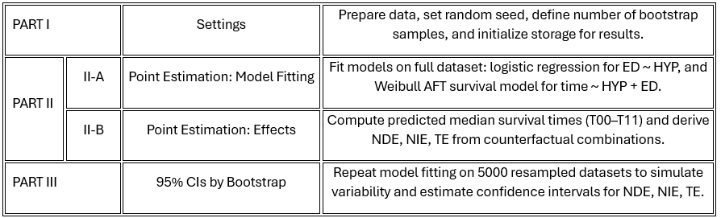
Mediation analysis in the AFT framework -Data analysis: Counterfactual mediation analysis-
Program algorithm
https://github.com/cristianricciwork-commits/aft-mediation./blob/main/Mediation%20analysis.R

Slide 48
Mediation analysis in the AFT framework -Data analysis: Counterfactual mediation analysis-
Program algorithm
https://github.com/cristianricciwork-commits/aft-mediation./blob/main/Mediation%20analysis.R

Slide 49
Mediation analysis in the AFT framework -Data analysis: Counterfactual mediation analysis-
Program algorithm
https://github.com/cristianricciwork-commits/aft-mediation./blob/main/Mediation%20analysis.R

Slide 50
Mediation analysis in the AFT framework -Data analysis: Counterfactual mediation analysis-
Program algorithm
https://github.com/cristianricciwork-commits/aft-mediation./blob/main/Mediation%20analysis.R

Slide 51
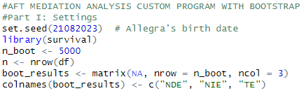
Mediation analysis in the AFT framework -Data analysis: Counterfactual mediation analysis-
We are using 5000 BOOTSTRAP replicates
An empty data frame where the 5000 BOOTSTRAP results are collected

Slide 52
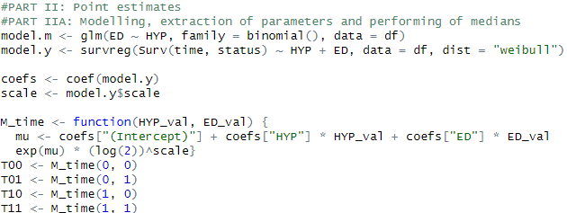
Mediation analysis in the AFT framework -Data analysis: Counterfactual mediation analysis-
Perform the ED ~ HYP (logistic) and T ~ ED + HYP (AFT
Extract the coefficients and the scale parameter
Perform medians of survival times for all combinations of HYP and ED

Slide 53
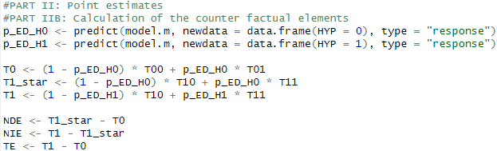
Mediation analysis in the AFT framework -Data analysis: Counterfactual mediation analysis-
P_ED_H0 → Probability of ED when HYP = 0
P_ED_H1 → Probability of ED when HYP = 1
Y0 → HYP = 0, ED from HYP = 0 → Baseline survival time
Y1_star → HYP = 1, ED from HYP = 0 (Only HYP changes) → Direct effect
Y1 → HYP = 1, ED from HYP = 1 (HYP and ED both change) → Total effect
Perform NDE, NIE and TE

Slide 54
Mediation analysis in the AFT framework -Data analysis: Counterfactual mediation analysis-
The previous steps of point estimates and performing of counterfactual effects are repeated 5000 times on a random subset of the data frame to perform the confidence limits…

Slide 55

The end, please help to improve ☺

